Slide 1
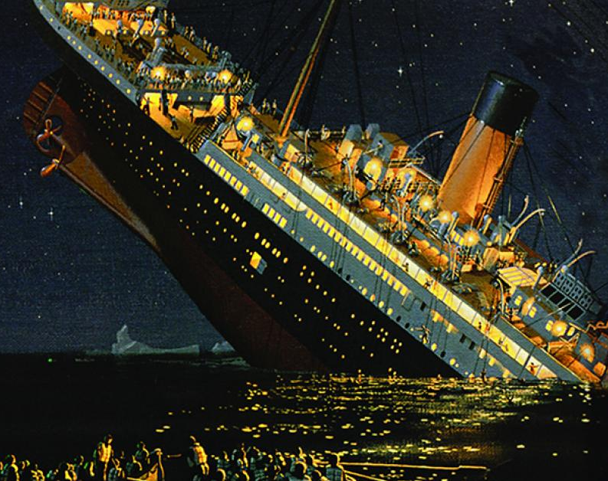
Titanic Survival Dataset

Slide 2
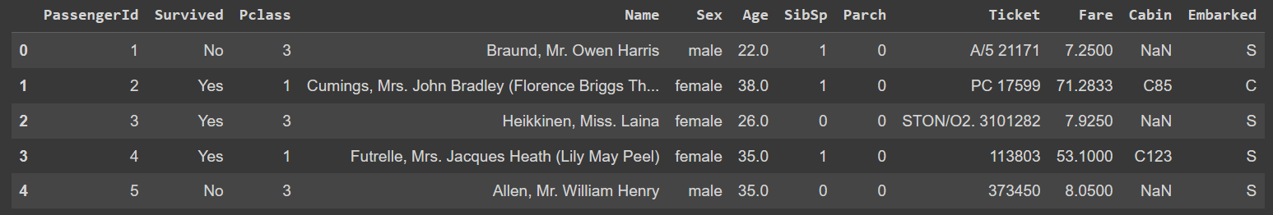
Problem description
Target
Features
Sibsp defines family relations (# of brother, sister, stepbrother, stepsister, …)
Parch defines family relations (# of mother, father, daughter, son, …)
Embarked is the port of Embarkation (C = Cherbourg, Q = Queenstown, S = Southampton)
Pclass is proxy for socio-economic status (1st = Upper, 2nd = Middle, 3rd = Lower)

Slide 3
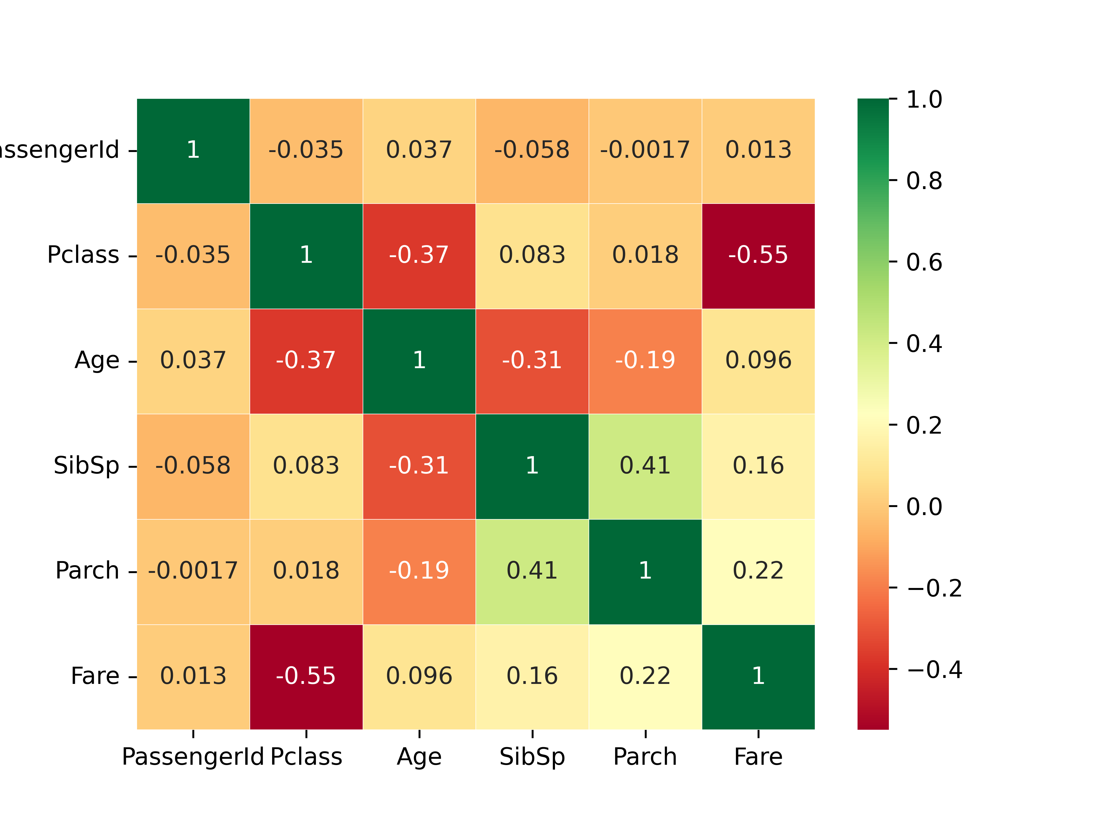
Data exploration
Total # of examples: 891
Data type: categorical and numerical
Missing data
Not balanced (549 no, 342 yes)

Slide 5
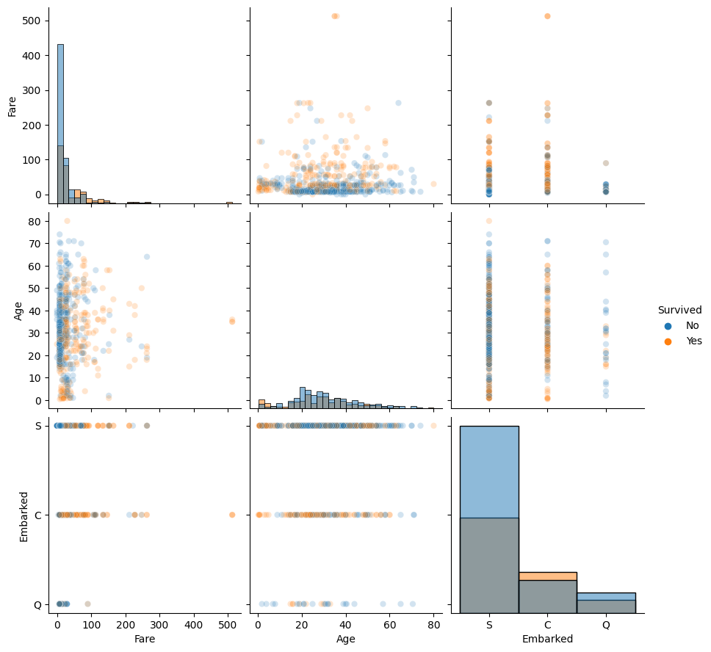

Slide 6
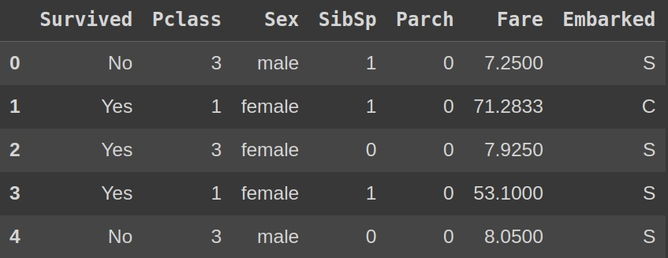
Features selection
Too many Nan
Correlated
Unuseful

Slide 7
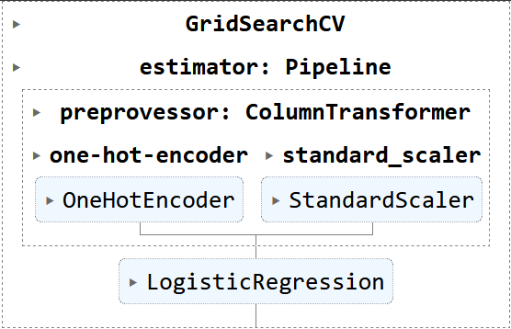
Machine Learning Models
ML Pipeline:
Preprocessing (categorical/numerical)
ML model
Hyperparameters Tuning:
Grid-search
Overfitting check:
Validation curve
Training-error vs Test-error table
ML Models:
SVM
Linear Discriminant Analysis
Logistic Regression
Gradient Decent
Decision Tree
AdaBoostClassifier
Naive Bayes
Random Forest
KNN
Performance Metrics:
Balanced accuracy
Model vs Dummy Classifier
AUC (ROC-Curve)
AP (PR-Curve)

Slide 8
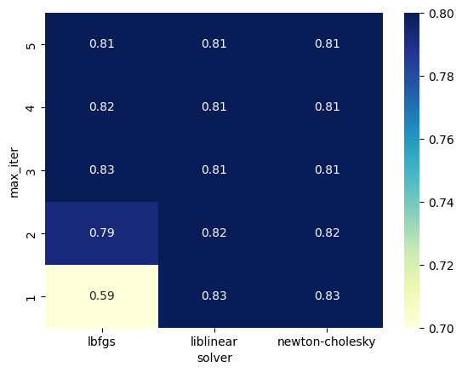
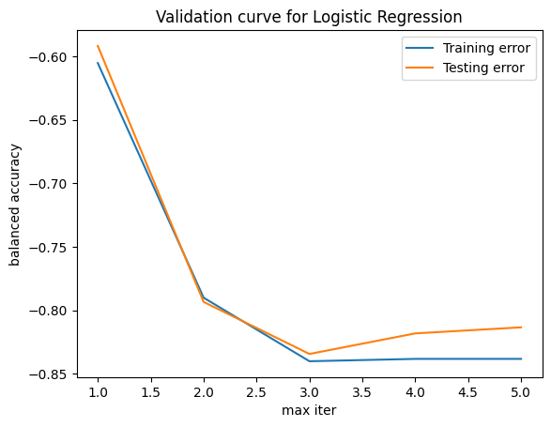
Logistic Regression: tuning and overfitting
solver: liblinear (dataset piccolo)
max_iter: 3

Slide 9
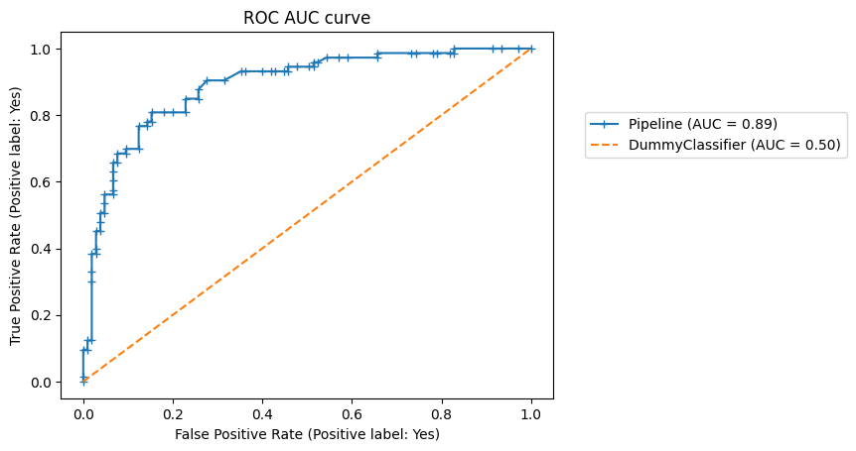
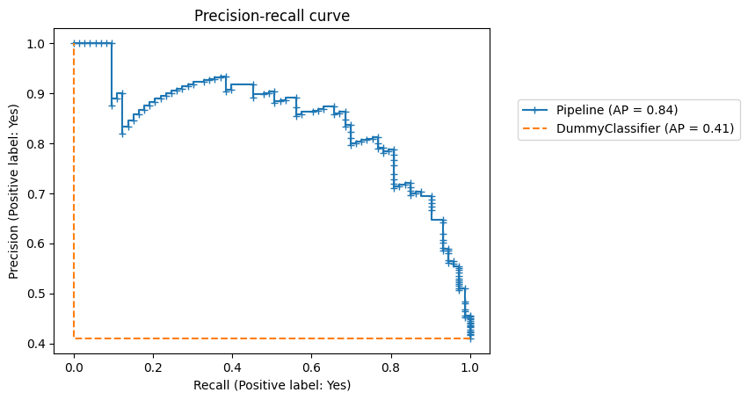
Logistic Regression
Balanced accuracy: 0.82

Slide 10
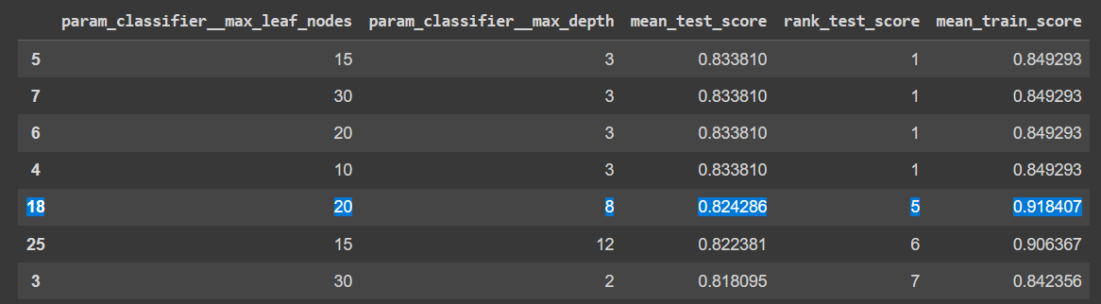
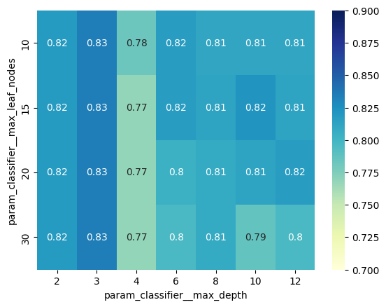
Decision Tree: tuning and overfitting
max_depth: 3
max_leaf_nodes: 10

Slide 11
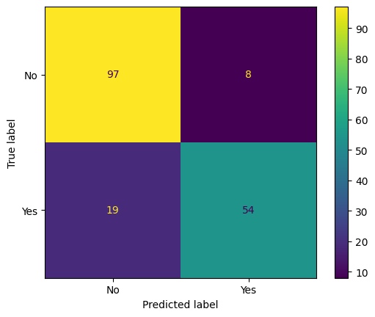
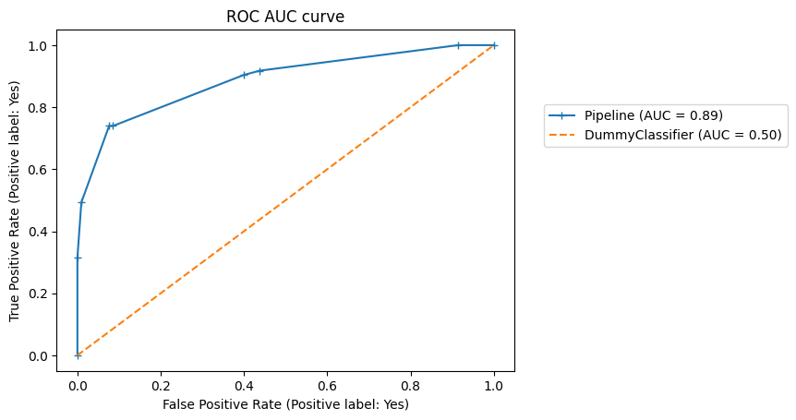
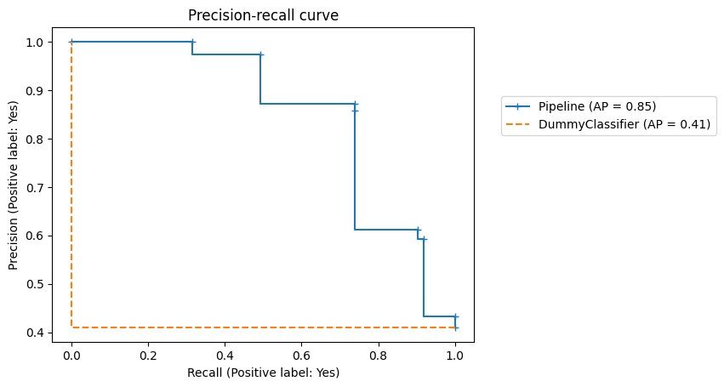
Decision Tree
Balanced accuracy: 0.83

Slide 12
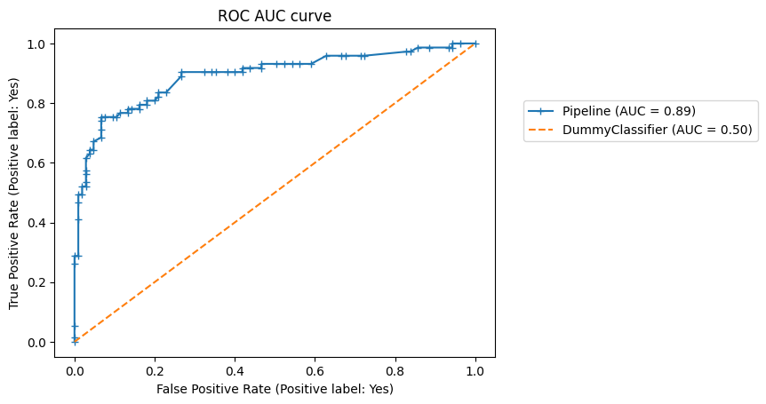
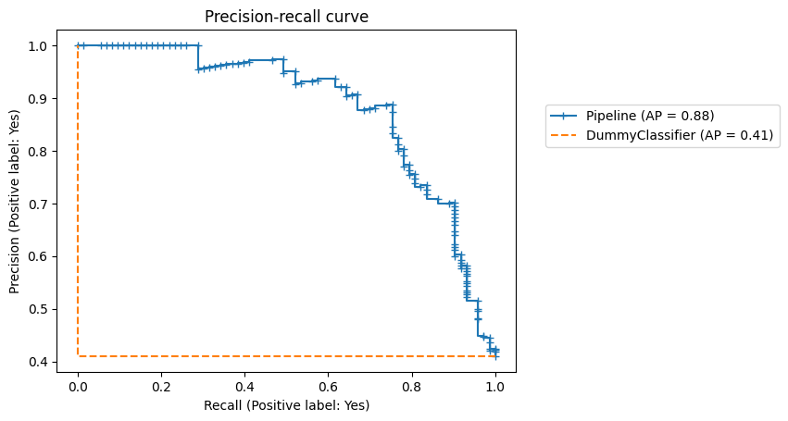
Random Forest
Decision trees tend to overfitting -> high variance and low bias
A possible solution to improve performance is Bagging -> Random Forest
n_estimators: 150
max_depth: 3
Balanced accuracy: 0.84

Slide 13
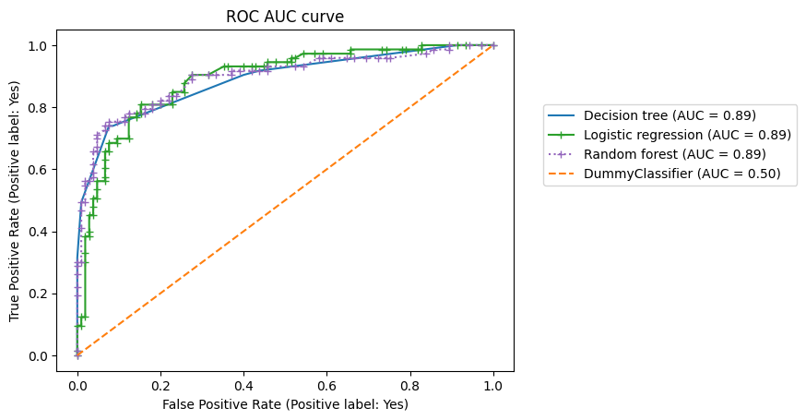
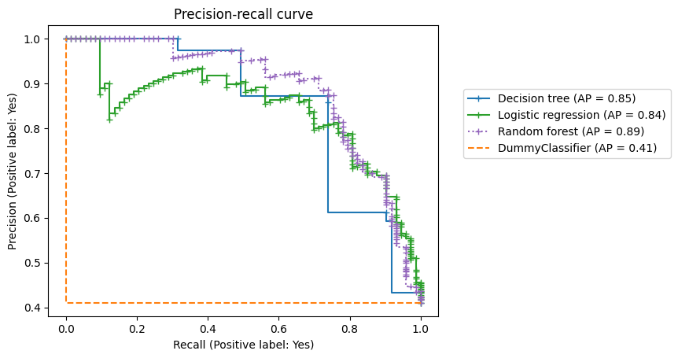
Model performance comparison

Slide 14
Conclusions
The performance of the three models is similar
The Random Forest seems to perform better (see AP values)
Changing the set of features (adding ‘Age’ and ‘Cabin’) does not improve the performance
In the future it woud be interesting to evaluate other classifiers

Slide 15
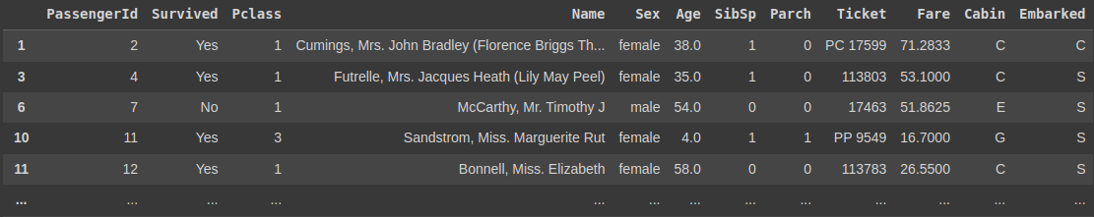

Slide 16
Grazie per l’attenzione

